Slide 1

EE460J Final Project:
What’s in your Fridge?≈
James Sullivan
Zachary Chilton
Young Joon Lee
Royce Hong
Erick Li
Zander Tedjo
University of Texas at Austin
EE460J Data Science Lab
Dr. Alexandros G. Dimakis
Notes:
Hello, and welcome to our final project video for “What’s in your Fridge?”, which seeks to answer the question of what we can put together from what we have.

Slide 2
Problem Description
User uploads an image of their fridge
Our model processes the image
Suggests recipes based on segmented ingredients
Notes:
The idea is simple; a user wants to be able to take a picture of the inside of their fridge to figure out what recipes they can make from its contents. Our job is obviously the difficult part; figuring out the areas of their image that could be a grocery item, figuring out what that grocery item is, and then taking all of those identified items to search for what they can make.

Slide 3
Overview
Grocery object detection and region proposal using Region-based Convolutional Neural Networks (R-CNN)
Food image classification with Tensorflow and Transfer Learning
Recipes from Spoonacular API
Notes:
[need ideas]

Slide 4
Datasets
Lionbridge Free Grocery Images
Microsoft Cognitive Toolkit (CNTK) Grocery Dataset
Klasson’s Grocery Store Image Dataset with Visual and Semantic Labels
Food 101 Dataset
Freiburg Groceries Dataset
Common Objects in Context (COCO) Dataset
MVTec Densely Segmented Supermarket Dataset (MVTec D2S)
Notes:
Thankfully, food is pretty common in our lives, so there were already quite a few datasets dedicated to classifying it. [more]

Slide 5
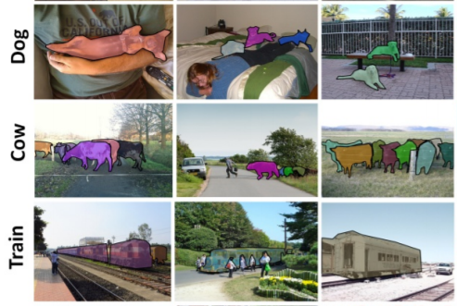
COCO Dataset
Dataset for object detection, segmentation, and captioning
1.5 million object instances
80 object categories

Slide 6
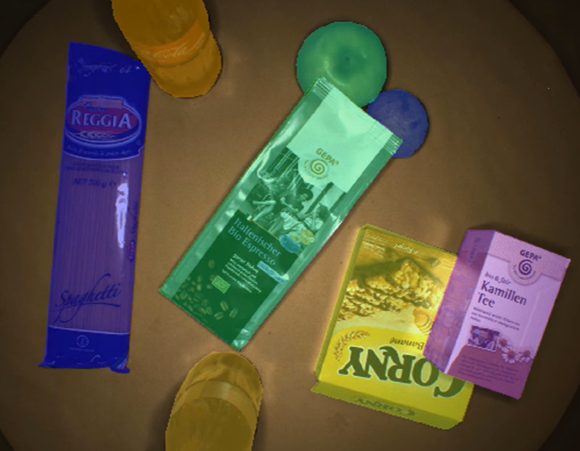
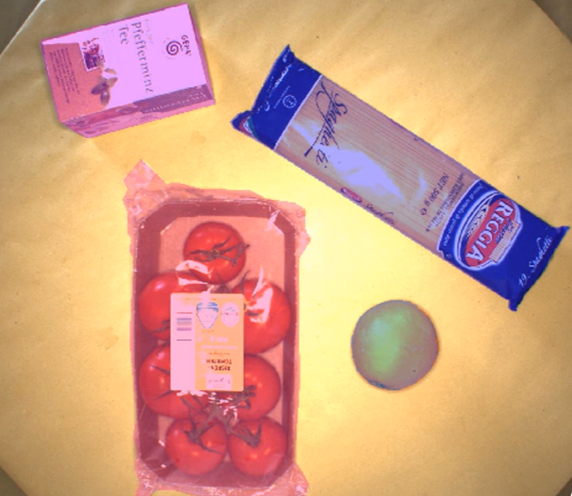
MVTec Dataset
21,000 high-resolution images with pixel-wise labels
Groceries from 60 different categories
Training images only contain objects of a single class
Same format as the COCO dataset

Slide 7
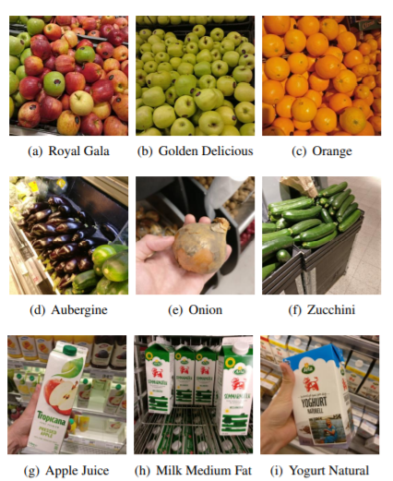
Klasson’s Grocery Store Dataset
5,125 images
81classes

Slide 8
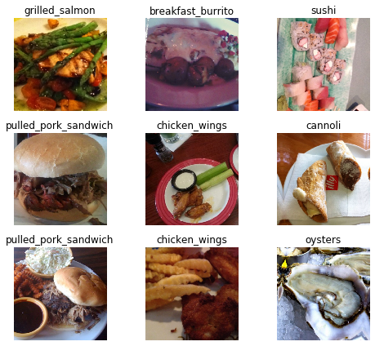
Food 101 Dataset
101,000 images
101 classes

Slide 9
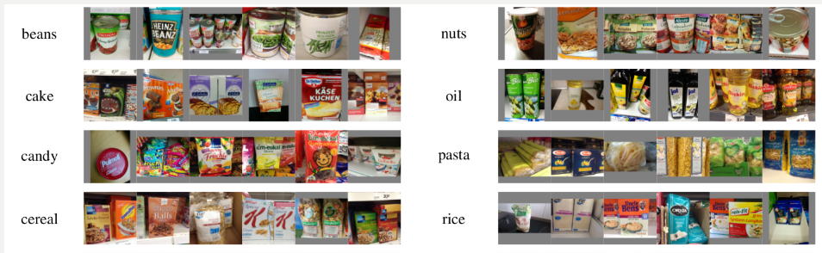
Freiburg Groceries Dataset
5,000 images
25 classes

Slide 10
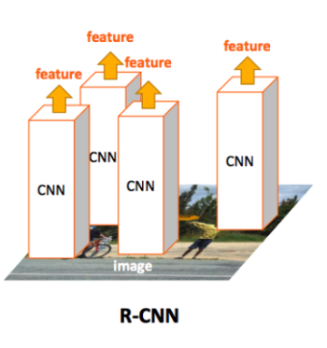
R-CNN
Extract regions and feature vectors
Crops and performs CNN for every proposed region
Classifies region-based features
Source: Ren et al., 2016
Notes:
You can see on the left here what was explained on the previous slide; fixed regions on the left being fed into a convolutional neural network repeatedly, whereas on the right the entire image is fed at once in order to identify regions and attempt classification on those.

Slide 11
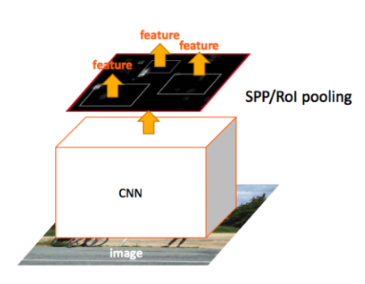
Fast R-CNN
Extract feature map first
Extract features from feature map regions
Perform cropping and CNN on feature map level (once)
Source: Ren et al., 2016

Slide 12
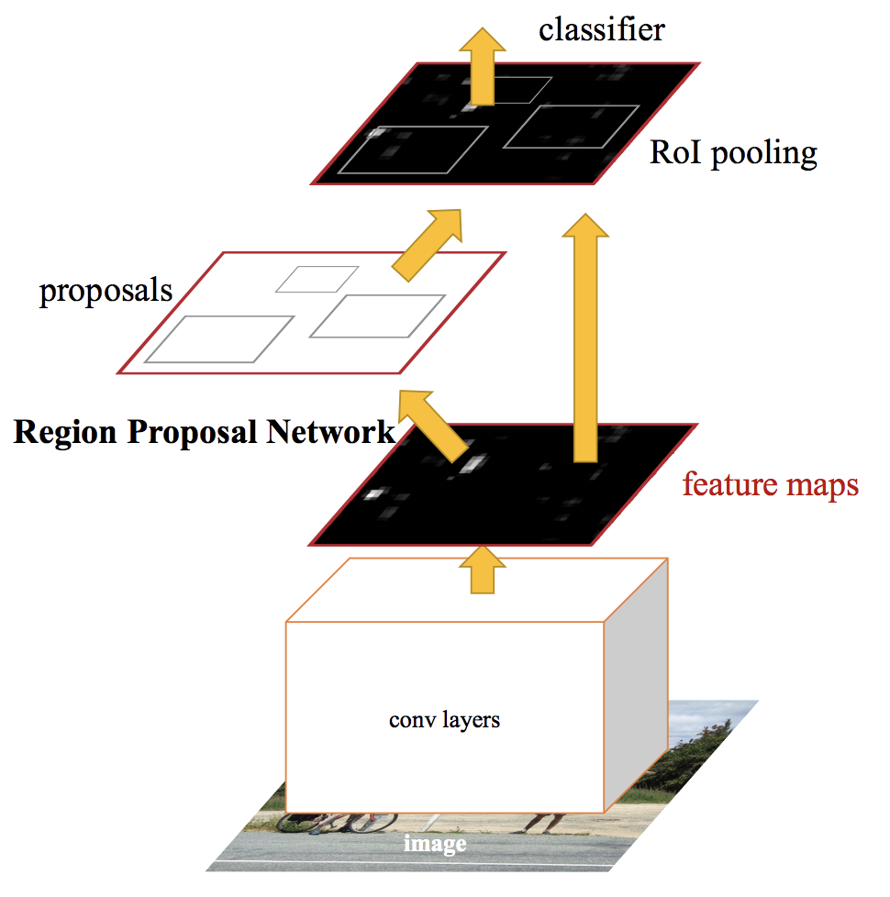
Faster R-CNN
Included region proposal network within CNN
Faster than Fast R-CNN
Source: Ren et al., 2016

Slide 13
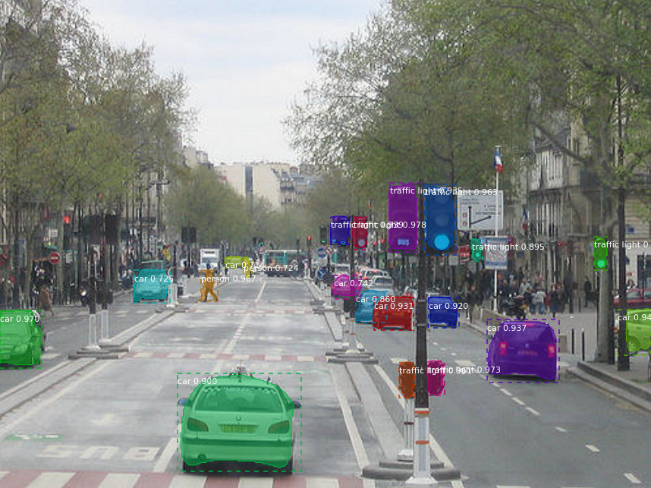
Mask R-CNN
Built on top of Faster RCNN
Predicts objects outline within bounding box

Slide 14
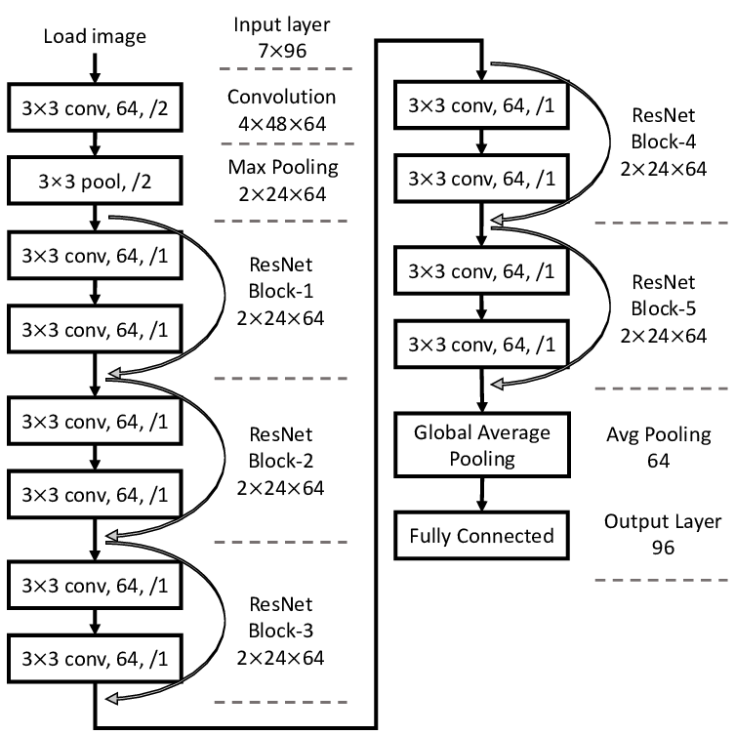
Classification
ResNet architecture
Accuracy: 0.68

Slide 15
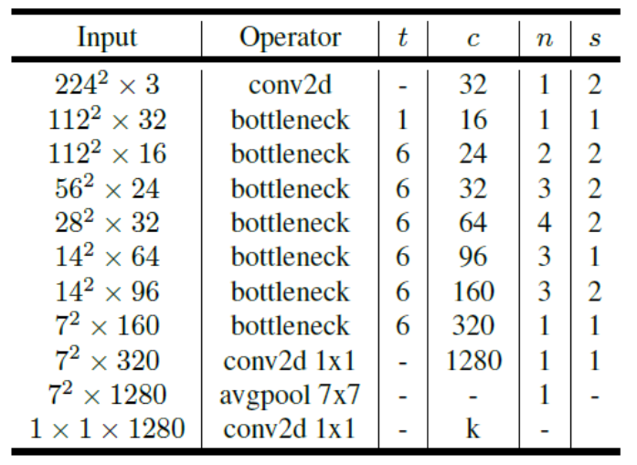
Classification
MobileNet architecture
Accuracy: 0.92

Slide 16

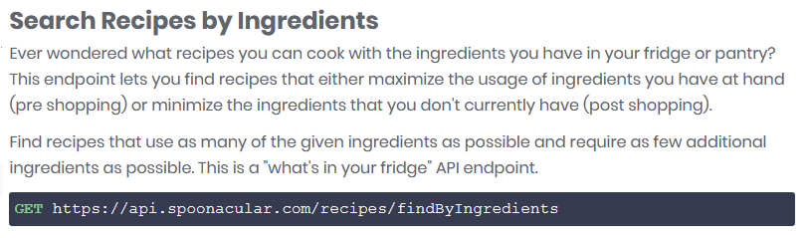
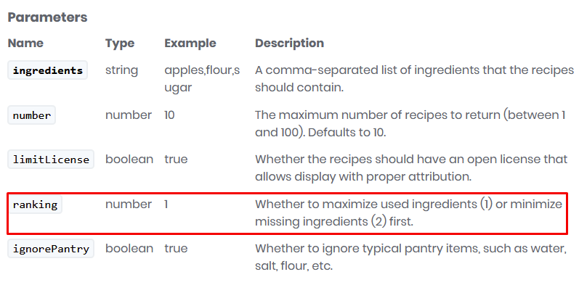
API

Slide 17
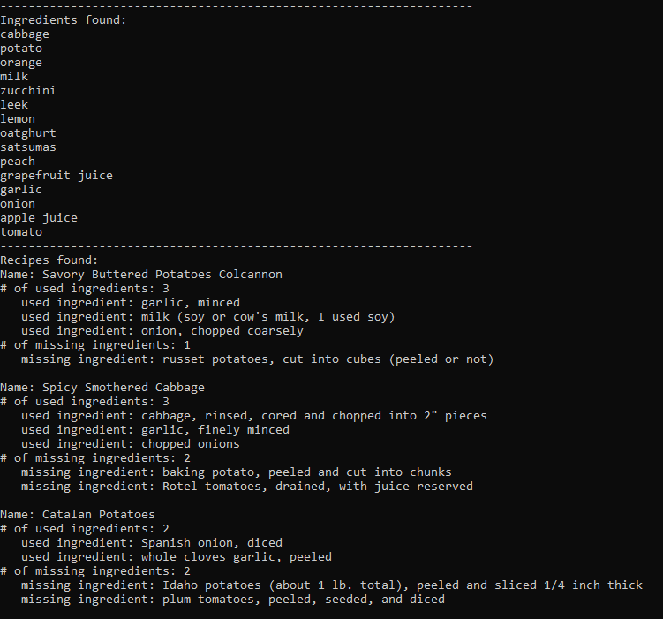
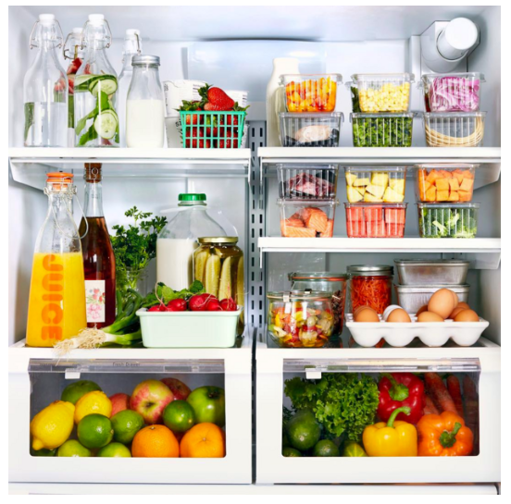
Demo

Slide 18
Challenges/Next Steps
Better connecting our region proposal model and our classification model
Incorporating more data into our models

Slide 19
Thank you!
James Sullivan Zachary Chilton Young Joon Lee
Royce Hong Erick Li Zander Tedjo

Slide 20
References
https://arxiv.org/abs/1901.00711
http://aisdatasets.informatik.uni-freiburg.de/freiburg_groceries_dataset/
https://www.kaggle.com/dansbecker/food-101#food-101.zip
https://towardsdatascience.com/r-cnn-fast-r-cnn-faster-r-cnn-yolo-object-detection-algorithms-36d53571365e
https://www.mvtec.com/company/research/datasets/mvtec-d2s/
http://cocodataset.org/#home

